Slide 1
C Flow Control
By: Lt FElipe Pineda

Slide 2
Overview
What is a string?
Declaring a string
Initializing a string
Assigning values to strings
Using string functions

Slide 3

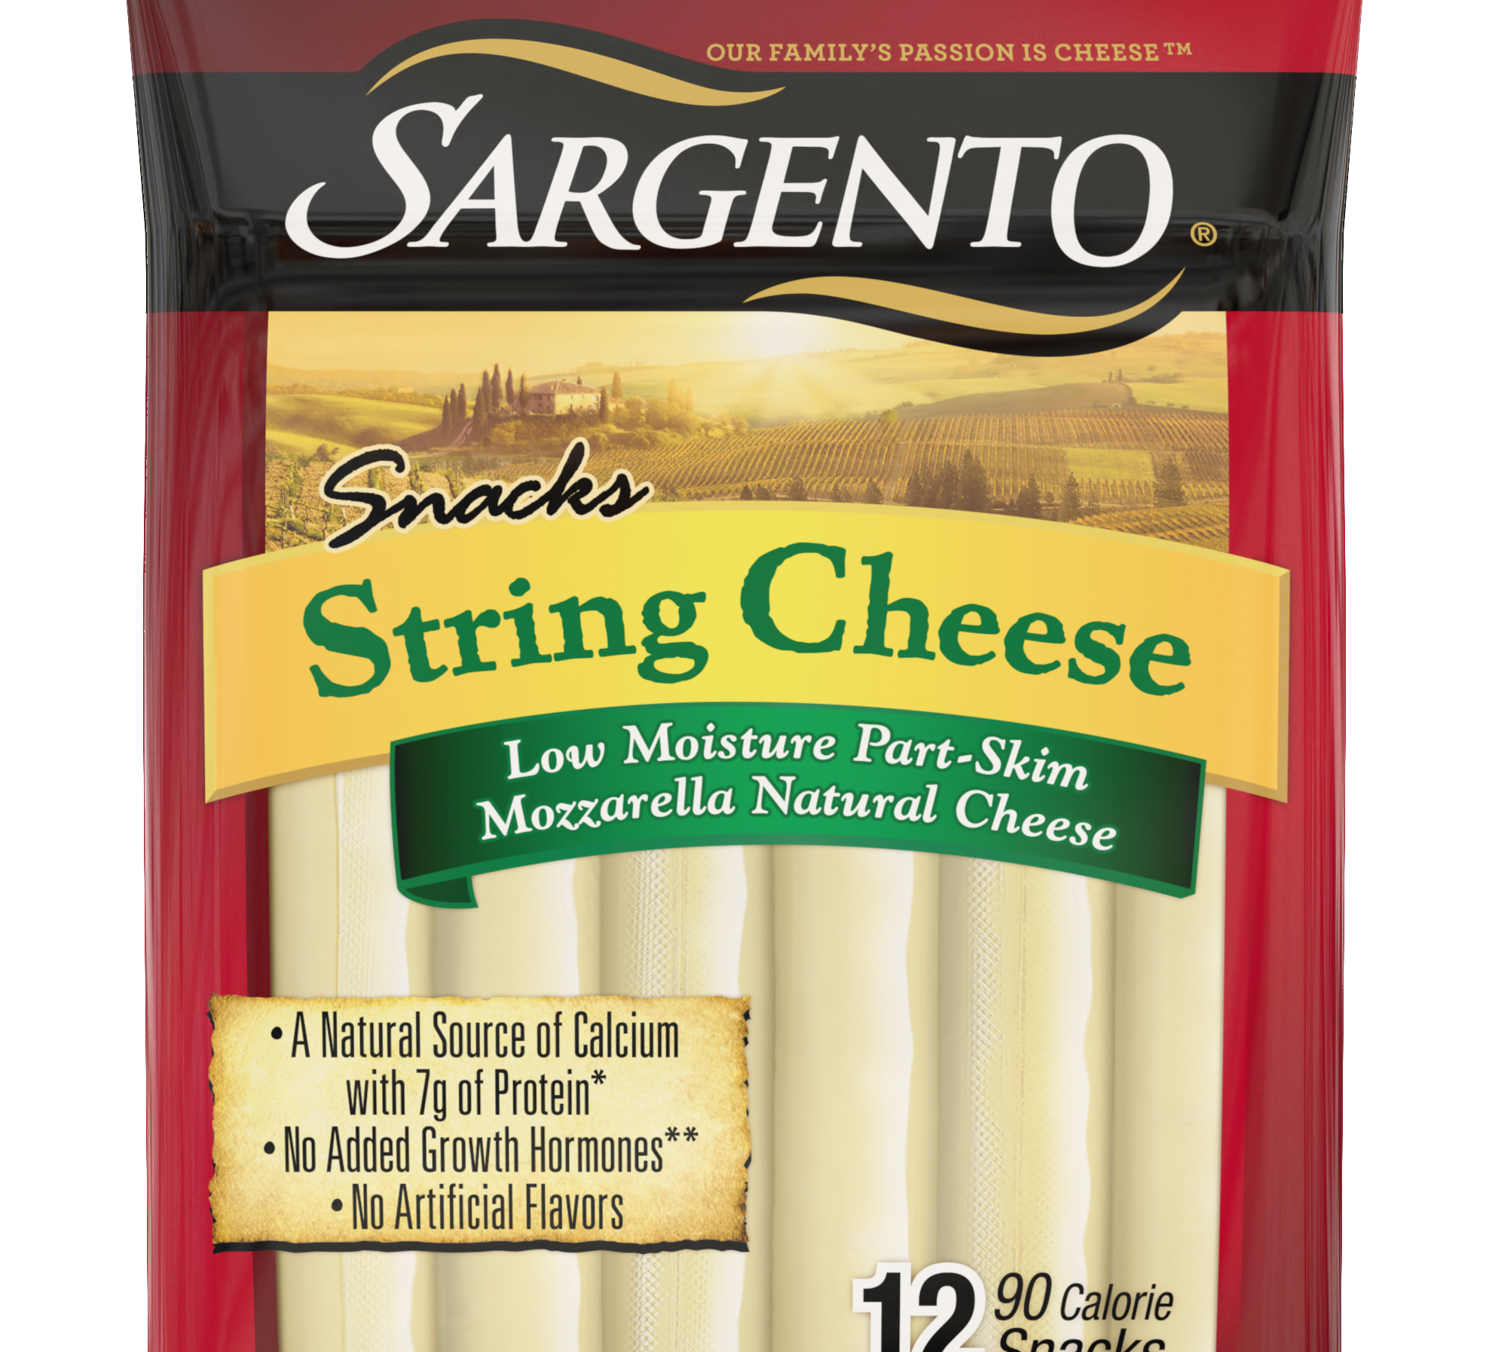
What is a string?
Sequence of type char values
It’s a special kind of array
When grouped together, it creates a string (sentence, word, letter)
Make sure you get use to using the word string, it’s errwhere
*So image an array that has char values inside it*
IT MUST BE TERMINATED WITH A NULL CHAR
\0
Notes:
String is a sequence of characters (type char) terminated with a null character (\0)
It is a special kind array where all the values (which are type char) are combined together to create a string

Slide 4
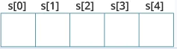
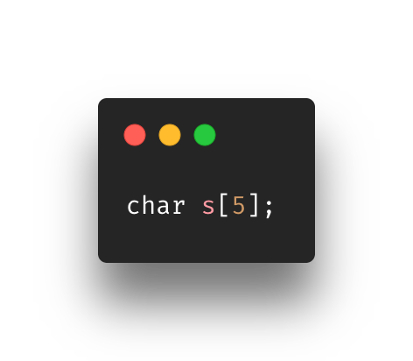
Declaring a string

Slide 5
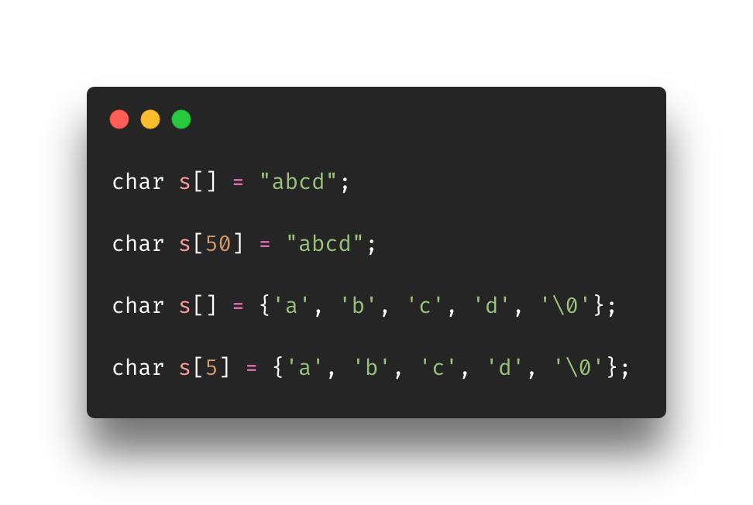
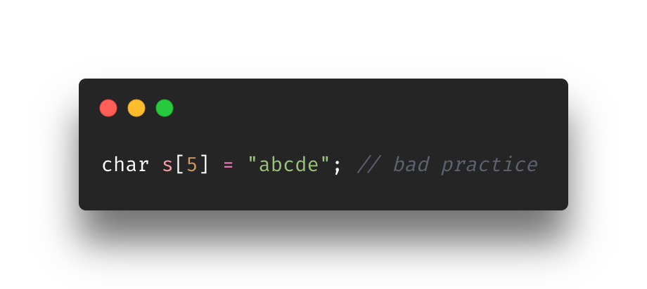
Initializing a string
Must have type char
Must be set as an array
Single char, multiple chars, or entire string as the value
Null character can be added or left out but either way it’ll be added by default by the compiler
Make space for it
Notes:
Setting s string is similar to how you set a char but you do it as an array and put more than one character

Slide 6
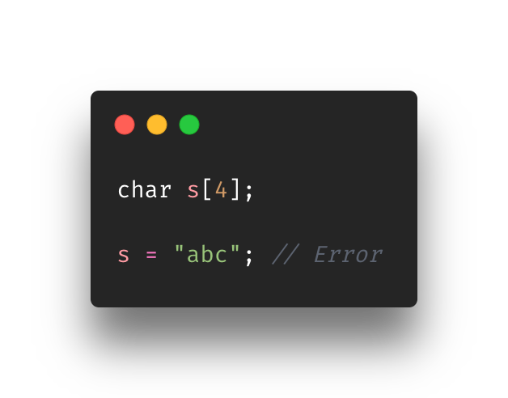
Assigning values to strings (or not)
Strings do not support the assignment operator
Once you declare a string, you can’t assign anything after the declaration line
So… you must declare it and initialize it
There are ways around it tho
We’ll see it in the next slides

Slide 7
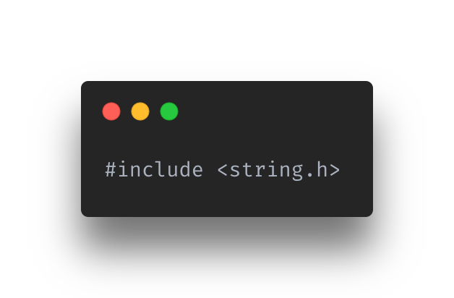
Using string functions
Strings are unique “types”
There are many functions to use
To simplify it we will cover
strlen()
strcpy()
strcmp()
strcat()
These functions require you to include the string.h file
Notes:
Strings are unique ”types” They are technically arraying so a lot functional uses items for it requires functions.
I could lecture you on all the possible functions you could use for the string, but it would take days for to cover all of the. Instead, we will look at the most commonly used
strlen() takes the length of the string
strcpy() copies the string from a source to a destination
strcmp() compares two strings
strcat() concatenates two strings

Slide 8
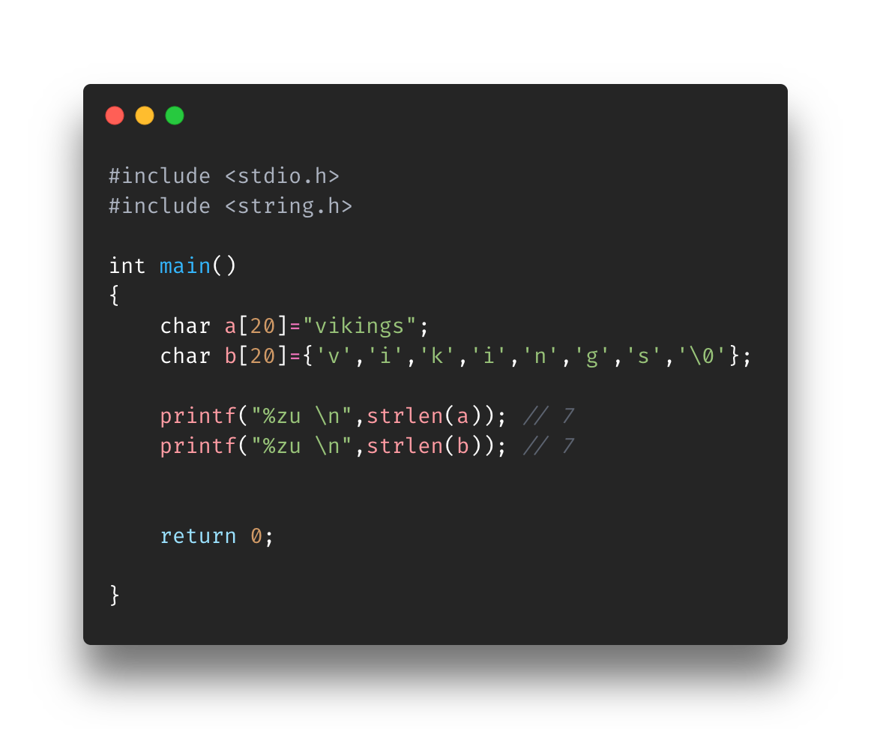
Using String Functions: strlen(…)
Arguments: string
Returns: unsigned int value (size)
Prints out length of a given string

Slide 9
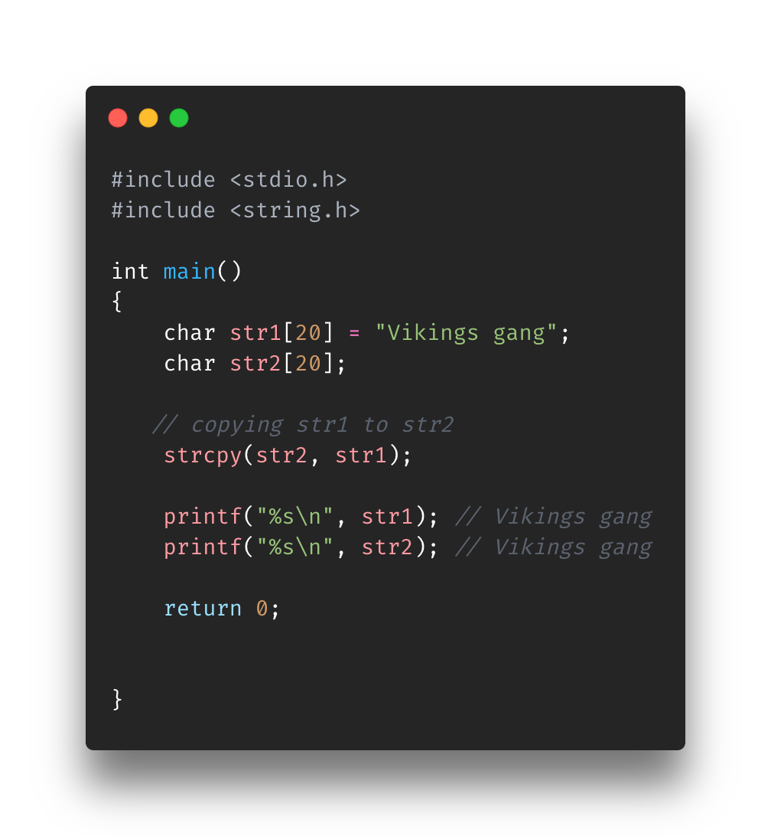
Using String Functions: strcpy(…)
Arguments: destination, source
Destination should be enough size
Copies the source string to the destination
Used as the work around to add a string to an already-declared string

Slide 10
Using String Functions: strcmp(…)
Arguments: string1, string2
Returns:
0 (if strings were equal)
nonzero (if strings were not equal)
Compares two strings (character by character)
Can be used in if statements, for loops, etc. as expressions

Slide 11

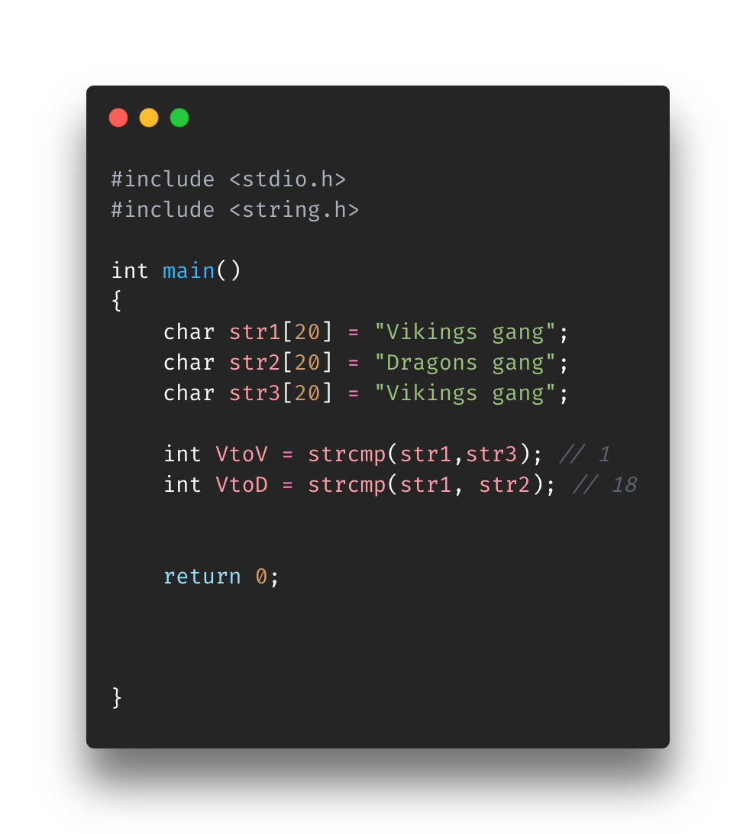
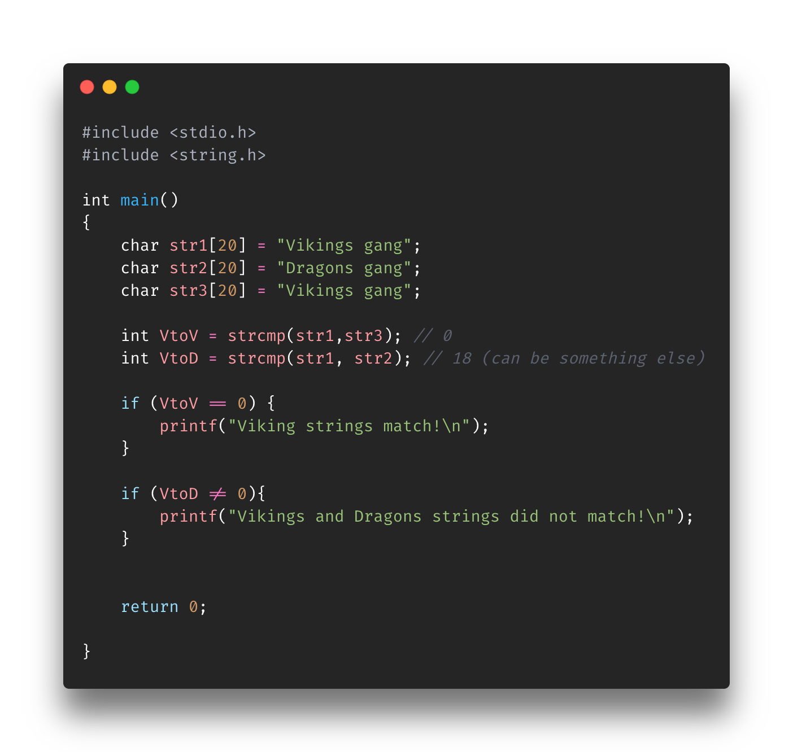

Slide 12
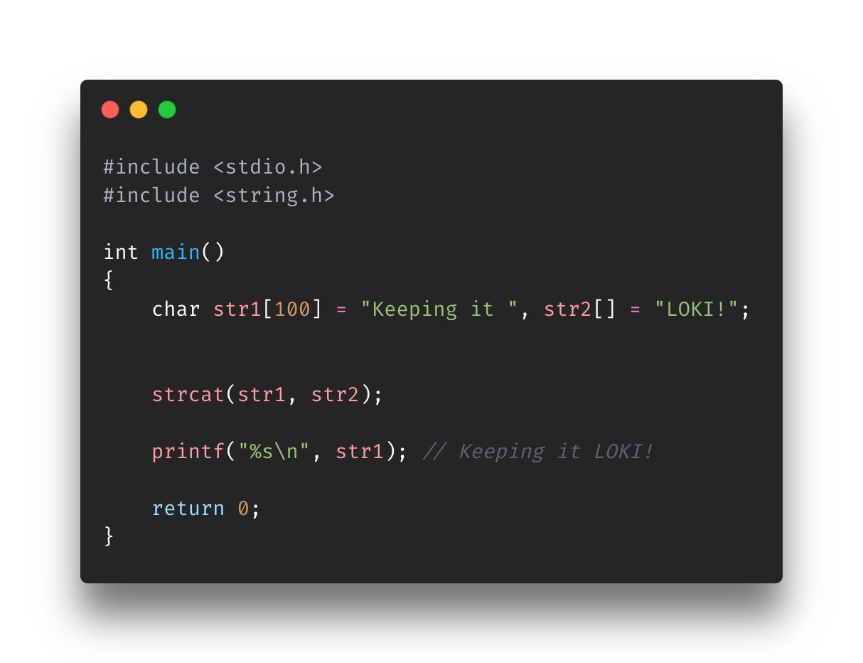
Using String Functions: strcat(…)
Arguments: Destination, Source
Joins to strings and puts the final string in the Destination string argument

Slide 13
Exercise
Find UsingStrings-Exercise.c in the Exercise folder for Section7-Strings
Instructions on are the script. Be careful with the sizes if you change stuff.
341 COS
match
7
I left something out that will cause some issues. Let’s see if you were listening :P

Slide 14
Overview
What is a string?
Declaring a string
Initializing a string
Assigning values to strings
Using string functions

Slide 15
References
https://www.freecodecamp.org/news/the-c-beginners-handbook/#arrays
https://www.programiz.com/c-programming/c-strings
https://www.techonthenet.com/c_language/standard_library_functions/string_h/strcmp.php

